Slide 1
Sequential Circuit Analysis

Slide 2
Synchronous vs. Asynch.
Synchronous sequential circuit:
Behavior: from knowledge of its signals at discrete instants of time.
Synchronization by a signal: clock
Asynchronous sequential circuit:
Behavior: dependent on the order of input signal changes over continuous time
Output can change at any time (clockless).

Slide 3
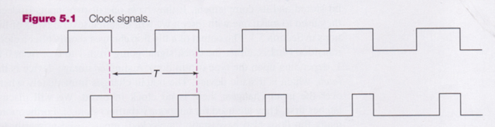
Clock Signal
Rising Clock Edge
Clock generator: Periodic train of clock pulses
Different duty cycles
Falling Clock Edge

Slide 4
Clock Signal
Clock is distributed throughout the whole design
Each component synchronizes itself with it.

Slide 5
Synchronous Circuits
Combinational
Logic
clk
time

Slide 6
Synchronous Circuits
Combinational
Logic
clk
time

Slide 7
Synchronous Circuits
Combinational
Logic
clk
time

Slide 8
Synchronous Circuits
Combinational
Logic
clk
time

Slide 9
Sequential Circuit Analysis
Analysis:
Obtaining a suitable description that demonstrates the time sequence of inputs, outputs, and states.

Slide 10
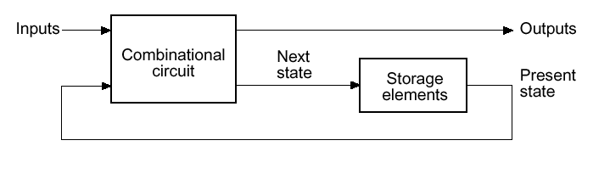
Sequential Circuits
At each clock period, the present state of the system is stored in storage elements (FFs)

Slide 11
Example 1
Input: x(t)
Output: y(t)
State: (A(t), B(t))
What is the Output Function?
What is the Next State Function?
x
D
Q
A
C
Q
A
D
Q
B
CP
C
Q
y

Slide 12
Example 1 (Cont’d)
Boolean equations for the functions:
A(t+1) = A(t)x(t) + B(t)x(t)
B(t+1) = A’(t)x(t)
y(t) = x’(t)(B(t) + A(t))
x
Q
A
D
C
Q
A’
Next State
D
Q
B
CP
C
Q'
y
Output

Slide 13
Example 1 (Cont’d)
A(t), B(t)
A(t+1), B(t+1)
A(t+1) = A(t)x(t) + B(t)x(t)
B(t+1) = A’(t)x(t)
y(t) = x’(t)(B(t) + A(t))
A(t), B(t)
1
A(t+1)
0
B(t+1)
1
0
0
A(t)
0
1
B(t)
0
Has error?

Slide 14
Example 1 (Cont’d)
A(t), B(t)
A(t+1), B(t+1)
A(t+1) = A(t)x(t) + B(t)x(t)
B(t+1) = A’(t)x(t)
y(t) = x’(t)(B(t) + A(t))
A(t), B(t)
1
A(t+1)
0
B(t+1)
1
0
0
A(t)
0
1
B(t)
0
Has error?

Slide 15
State Table Characteristics
State table
A multiple variable table with the following four sections:
Present State:
the values of the state variables for each allowed state.
Input:
the input combinations allowed.
Next-state:
the value of the state at time (t+1) based on the present state and the input.
Output:
the value of the output as a function of the present state and (sometimes) the input.
A(t), B(t)
A(t+1), B(t+1)
A(t), B(t)

Slide 16
State Table Characteristics
From the viewpoint of a truth table:
TT inputs:
Input, Present State
TT outputs:
Output, Next State

Slide 17
State Table
Example:
The state table can be filled in using the next state and output equations:
A(t+1) = A(t)x(t) + B(t)x(t)
B(t+1) =‾A (t)x(t)
y(t) =‾x (t)(B(t) + A(t))
Present State
Input
Next State
Output
A(t) B(t)
x(t)
A(t+1) B(t+1)
y(t)
0 0
0
0 0
0
0 0
1
0 1
0
0 1
0
0 0
1
0 1
1
1 1
0
1 0
0
0 0
1
1 0
1
1 0
0
1 1
0
0 0
1
1
1
1
1 0
0

Slide 18
State Diagram
The sequential circuit function can be represented in graphical form as a state diagram with the following components:
Circles (state name inside): states
Directed arcs: Present State →Next State: state transition
label on each arc with the Input values which causes the state transition, and
A label for the output:
on each directed arc, or
on each circle
I/O
S1
S2
I
S1/O1
S2/O2

Slide 19
Mealy vs. Moore machines
Mealy model:
Both outputs and next state depend both on primary inputs AND present state.
Next_state = f(inputs, state)
Out = g(inputs, state)
Moore model:
Only next state depends directly on primary inputs AND present state. Outputs depend only on present state.
Next_state = f(inputs, state)
Out = g(state)

Slide 20
State Diagram
Label form:
Mealy:
On directed arc :
inputs/outputs
In circle:
State name
Moore:
On directed arc:
Inputs
In circle:
state/output
Mealy:
output g(state, input)
Moore:
output g(state)

Slide 21
Example: Mealy model (cont.)
State Diagram
0/0
1/0
I/O
00
01
S1
S2
0/1
Reads as: When at state s1 and apply
input I, we get output O
and proceed to state s2.
0/1
0/1
1/0
10
1/0
11
1/0

Slide 22
Example: Moore model (cont.)
State Diagram
11
00
01
10
I
0/0
1/1
S1/O1
S2/O2
01
10
11
Reads as: When at state s1 with output
O1 and apply input I,
we proceed to state s2 with
Output O2.
00

Slide 23
Example: Moore model (cont.)
State Diagram
11
00
01
10
I
0/0
1/1
S1/O1
S2/O2
01
10
11
Reads as: When at state s1 with output
O1 and apply input I,
we proceed to state s2 with
Output O2.
00
00,11
01,10
0/0
1/1
01,10
00,11

Slide 24
State Diagram
x=0/y=0
x=0/y=1
Which type?
x=1/y=0
A B
0 0
x=0/y=1
1 0
x=1/y=0
x=1/y=0
x=0/y=1
0 1
1 1
x=1/y=0

Slide 25
General Sequential Circuit

Slide 26
Mealy Machine
C1
C2
s(t+1)
State Register
next
state
s(t)
x(t)
present
state
z(t)
present
inputs
clock

Slide 27
Moore Machine
C2
C1
s(t+1)
z(t)
State Register
next
state
s(t)
x(t)
present
state
present
inputs
clock

Slide 28
Example of a M…? machine
Obtain the logic diagram and state table for:
D_{A} = A ⊕ X ⊕ Y
Z = A

Slide 29
Example of a M…? machine
Obtain the logic diagram and state table for:
D_{A} = A ⊕ X ⊕ Y
Z = A
X
D_{A}
A
D
Z
Y
C
clock

Slide 30
Example of a Moore Machine (cont.)
State Table
Present State | Inputs |  | Next State | Output
A(t) | X | Y | A(t+1) | Z
X
D_{A}
D
A
Z
Y
C
clock

Slide 31
Example of a Moore Machine (cont.)
State Table
Present State | Inputs |  | Next State | Output
A(t) | X | Y | A(t+1) | Z
0 | 0 | 0 | 0 | 0
0 | 0 | 1 | 1 | 0
0 | 1 | 0 | 1 | 0
0 | 1 | 1 | 0 | 0
1 | 0 | 0 | 1 | 1
1 | 0 | 1 | 0 | 1
1 | 1 | 0 | 0 | 1
1 | 1 | 1 | 1 | 1
X
D_{A}
D
A
Z
Y
C
clock

Slide 32
Example of a Moore Machine (cont.)
State Table
Alternative State Table
Present State | Inputs |  | Next State | Output
A(t) | X | Y | A(t+1) | Z
0 | 0 | 0 | 0 | 0
0 | 0 | 1 | 1 | 0
0 | 1 | 0 | 1 | 0
0 | 1 | 1 | 0 | 0
1 | 0 | 0 | 1 | 1
1 | 0 | 1 | 0 | 1
1 | 1 | 0 | 0 | 1
1 | 1 | 1 | 1 | 1
Present State | Next State |  |  |  | Output
 | XY=00 | XY=01 | XY=10 | XY=11
A(t) | A(t+1) | A(t+1) | A(t+1) | A(t+1) | Z
0 | 0 | 1 | 1 | 0 | 0
1 | 1 | 0 | 0 | 1 | 1
X
D_{A}
D
A
Z
Y
C
clock

Slide 33
Example: Mealy model
Y = (A+B).X’
A(t+1) = (A+B).X
B(t+1) = A’.X
State Table
Present State |  | Input | Next State |  | Output
A(t) | B(t) | X | A(t+1) | B(t+1) | Y
0 | 0 | 0 | 0 | 0 | 0
0 | 0 | 1 | 0 | 1 | 0
0 | 1 | 0 | 0 | 0 | 1
0 | 1 | 1 | 1 | 1 | 0
1 | 0 | 0 | 0 | 0 | 1
1 | 0 | 1 | 1 | 0 | 0
1 | 1 | 0 | 0 | 0 | 1
1 | 1 | 1 | 1 | 0 | 0
Possible states = { 00, 01, 10, 11 }
→ 4 nodes in state diagram

Slide 34
Example: Mealy model (cont.)
State Diagram
Present State |  | Input | Next State |  | Output
A(t) | B(t) | X | A(t+1) | B(t+1) | Y
0 | 0 | 0 | 0 | 0 | 0
0 | 0 | 1 | 0 | 1 | 0
0 | 1 | 0 | 0 | 0 | 1
0 | 1 | 1 | 1 | 1 | 0
1 | 0 | 0 | 0 | 0 | 1
1 | 0 | 1 | 1 | 0 | 0
1 | 1 | 0 | 0 | 0 | 1
1 | 1 | 1 | 1 | 0 | 0
0/0
1/0
00
01
0/1
0/1
0/1
1/0
10
1/0
11
1/0

Slide 35
Example: Moore model
State Table
Present State | Inputs |  | Next State | Output
A(t) | X | Y | A(t+1) | Z
0 | 0 | 0 | 0 | 0
0 | 0 | 1 | 1 | 0
0 | 1 | 0 | 1 | 0
0 | 1 | 1 | 0 | 0
1 | 0 | 0 | 1 | 1
1 | 0 | 1 | 0 | 1
1 | 1 | 0 | 0 | 1
1 | 1 | 1 | 1 | 1
Possible states = { 0, 1 }
→ 2 nodes in state diagram

Slide 36
Example: Moore model (cont.)
Present State | Inputs |  | Next State | Output
A(t) | X | Y | A(t+1) | Z
0 | 0 | 0 | 0 | 0
0 | 0 | 1 | 1 | 0
0 | 1 | 0 | 1 | 0
0 | 1 | 1 | 0 | 0
1 | 0 | 0 | 1 | 1
1 | 0 | 1 | 0 | 1
1 | 1 | 0 | 0 | 1
1 | 1 | 1 | 1 | 1
State Diagram
00,11
01,10
0/0
1/1
01,10
00,11

Slide 37
State Tables for Other Flip-Flops
Two step procedure:
Obtain binary values of each FF input equation in terms of present state and input variables.
Use corresponding FF characteristic table to determine the next state.

Slide 38
Example
JK-FF Characteristic Table
J_{A} = B, K_{A} = BX’
J_{B} = X’, K_{B} = AX’ + A’X = A ⊕ X
→ 2 JK-FFs:
JK-FF Characteristic Table
J | K | Q(t+1)
0 | 0 | Q(t)
0 | 1 | 0
1 | 0 | 1
1 | 1 | Q(t)’
J_{A}
J
A
C
K_{A}
K
A’
J_{B}
J
B
C
K_{B}
K
B’
38

Slide 39
Example (cont.)
Present State |  | Input | Next State |  | FF inputs
A(t) | B(t) | X | A(t+1) | B(t+1) | J_{A} | K_{A} | J_{B} | K_{B}
0 | 0 | 0 |  |  | 0 | 0 | 1 | 0
0 | 0 | 1 |  |  | 0 | 0 | 0 | 1
0 | 1 | 0 |  |  | 1 | 1 | 1 | 0
0 | 1 | 1 |  |  | 1 | 0 | 0 | 1
1 | 0 | 0 |  |  | 0 | 0 | 1 | 1
1 | 0 | 1 |  |  | 0 | 0 | 0 | 0
1 | 1 | 0 |  |  | 1 | 1 | 1 | 1
1 | 1 | 1 |  |  | 1 | 0 | 0 | 0
J_{A} = B, K_{A} = BX’
J_{B} = X’, K_{B} = AX’ + A’X = A ⊕ X
Step 1: Use FF input equations

Slide 40
Example (cont.)
Present State |  | Input | Next State |  | FF inputs
A(t) | B(t) | X | A(t+1) | B(t+1) | J_{A} | K_{A} | J_{B} | K_{B}
0 | 0 | 0 | 0 | 1 | 0 | 0 | 1 | 0
0 | 0 | 1 | 0 | 0 | 0 | 0 | 0 | 1
0 | 1 | 0 | 1 | 1 | 1 | 1 | 1 | 0
0 | 1 | 1 | 1 | 0 | 1 | 0 | 0 | 1
1 | 0 | 0 | 1 | 1 | 0 | 0 | 1 | 1
1 | 0 | 1 | 1 | 0 | 0 | 0 | 0 | 0
1 | 1 | 0 | 0 | 0 | 1 | 1 | 1 | 1
1 | 1 | 1 | 1 | 1 | 1 | 0 | 0 | 0
Step 2: Use FF inputs and JK characteristic table

Slide 41
Example 2: Sequential Circuit Analysis
A
Logic Diagram:
D
Q
Z
C
R
Q
B
D
Q
C
R
Q
C
D
Q
Clock
C
R
Q
Reset

Slide 42
Example 2: Flip-Flop Input Equations
Variables
Inputs: None
Outputs: Z
State Variables: A, B, C
Initialization:
Reset to (0,0,0)
Equations
A(t+1) = Z =
B(t+1) =
C(t+1) =
Mealy or Moore?
Notes:
A(t+1) = BC
B(t+1) = B’C + BC’
C(t+1) = A’C’
Z = A

Slide 43
Example 2: State Table
A B C | A⁺B⁺C⁺ | Z
0 0 0
0 0 1
0 1 0
0 1 1
1 0 0
1 0 1
1 1 0
1 1 1
S⁺=S(t+1)
Notes:
A’B’C’: 0 0 1, 0 1 0, 0 1 1, 1 0 0, 0 0 0, 0 1 0, 0 1 0, 1 0 0
Z: 0 0 0 0 1 1 1 1

Slide 44
Example 2: State Diagram
ABC
Reset
000
111
100
001
011
010
101
Which states are used?
What is the function of the circuit?
110
Notes:
Only states reachable from the reset state 000 are used: 000, 001, 010, 011, and 100.
The circuit produces a 1 on Z after four clock periods and every five clock periods thereafter:
000 -> 001 -> 010 -> 011 -> 100 -> 000 -> 001 -> 010 -> 011 -> 100 …
1 1

Slide 45
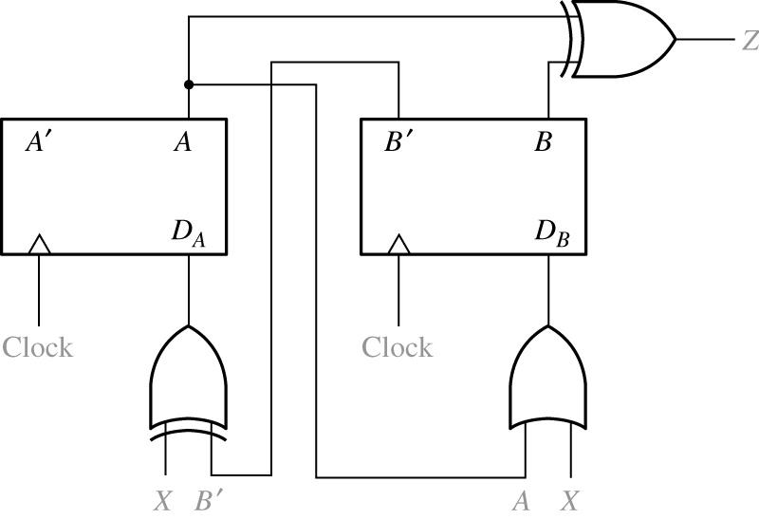
Example 3
Mealy or Moore?
00 01 11 10 | 01 00 11 01 11 11 01 | 0 1 0 1
Present
State
Next state
Present
Output(Z)

Slide 46
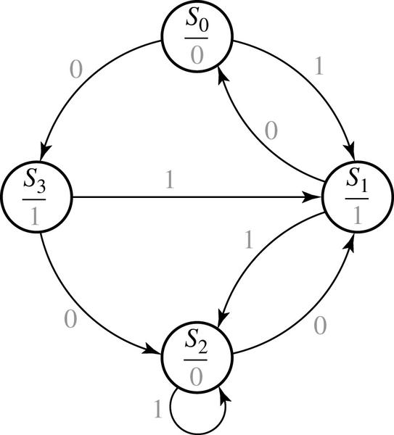
Example 3
Present State | Next state | Present Output(Z)

Slide 47
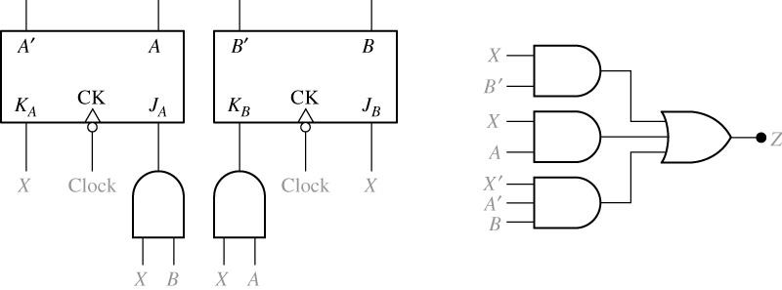
Example 4
Mealy or Moore?
Present
State
Next state
Present
Output(z)
00
01
11
10
00 01
01 11
11 00
10 01
0 1
1 0
0 1
0 1

Slide 48
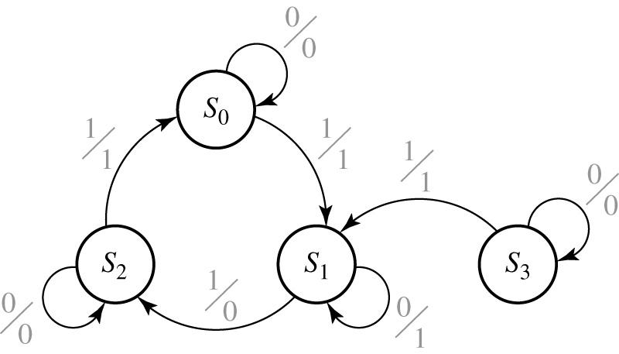
Example 4
Present State | Next state | Present Output(z)

Slide 49
Circuit Analysis by Signal Tracing
Waveforms

Slide 50
Timing Chart
Construction and interpretation of Timing Chart:
A state change can only occur after the rising (or falling) edge of the clock.
The input will normally be stable immediately before and after the active clock edge.
For a Mealy circuit, the output can change when the input changes as well as when the state changes.
A false output may occur between the state changes and the time the input is changed to its new value. (In other words, if the state has changed to its next value, but the old input is still present, the output may be temporarily incorrect.)
False outputs are difficult to determine from the state graph, so use signal tracing.

Slide 51
Timing Charts
Timing chart plotting procedure for Mealy state table :
For the given input value, read the present output and plot it.
If the input changes many times before clock edge, plot the effects on output.
After the active clock edge, change the present state according to the next state function.
Any change in present state may cause change in next state and output.
Repeat steps (a) and (b).
For Mealy circuits, the best time to read the output is just before the active edge of the clock, because the output should always be correct at that time.

Slide 52
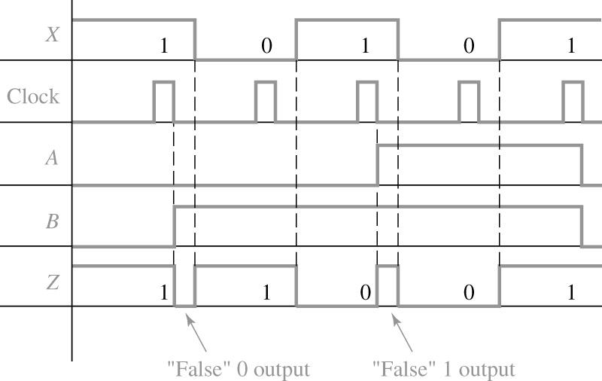
Example
Timing Chart for a Mealy Machine
(False outputs are indicated in parentheses)
X = 1 0 1 0 1
A = 0 0 0 1 1 0
B = 0 1 1 1 1 0
Z = 1(0) 1 0(1) 0 1

Slide 53
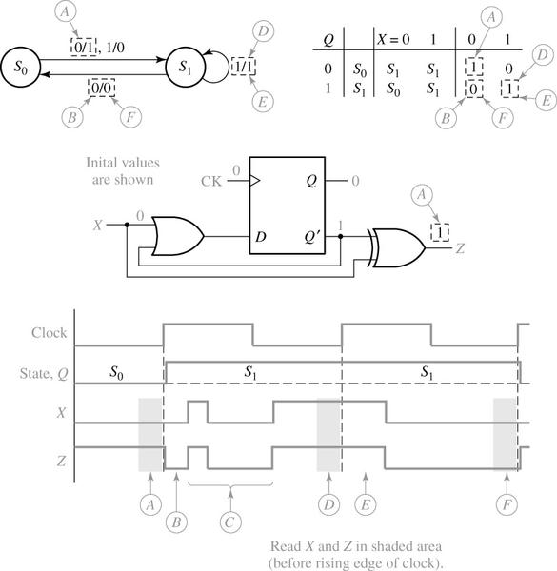
Example

Slide 54
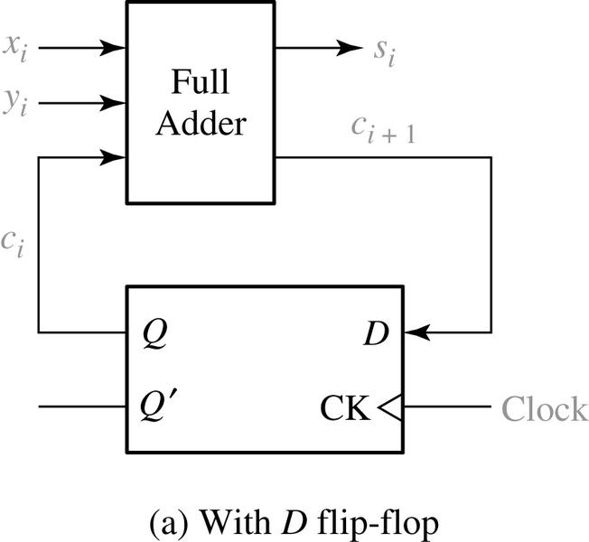
Example: Serial Adder
x_{i} y_{i} c_{i} | c_{i+1} s_{i}
0 0 0 0 0 1 0 1 0 0 1 1 1 0 0 1 0 1 1 1 0 1 1 1 | 0 0 0 1 0 1 1 0 0 1 1 0 1 0 1 0
(b) Truth table

Slide 55
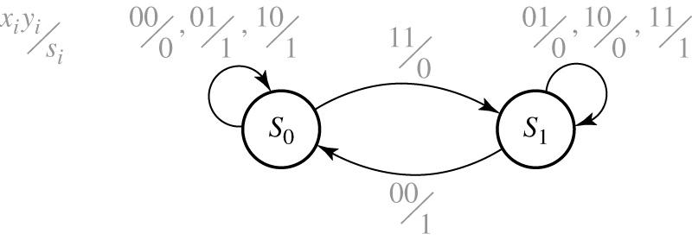
Serial Adder
State Diagram
S₀: Q = 0
S₁: Q = 1

Slide 56
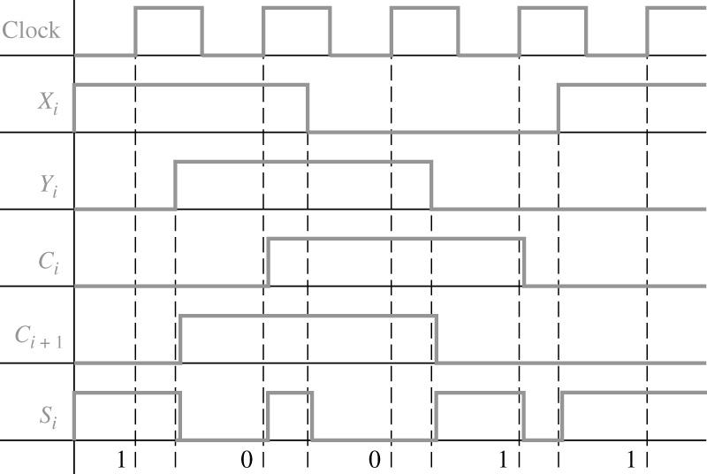
Serial Adder Timing Diagram
S_{i} can be read before the rising edge of Clock
At 2nd clock: X_{i}=Y_{i}=1, C_{i}=0 → S_{i}=0
But after clock, C_{i} changes, but old X_{i}
→ S_{i} changes to a wrong value.
10011 x_{i}
00110 y_{i}

Slide 57
State Tables
A State table with Multiple Inputs and Outputs
Present State | Next state | Present Outputs

Slide 58
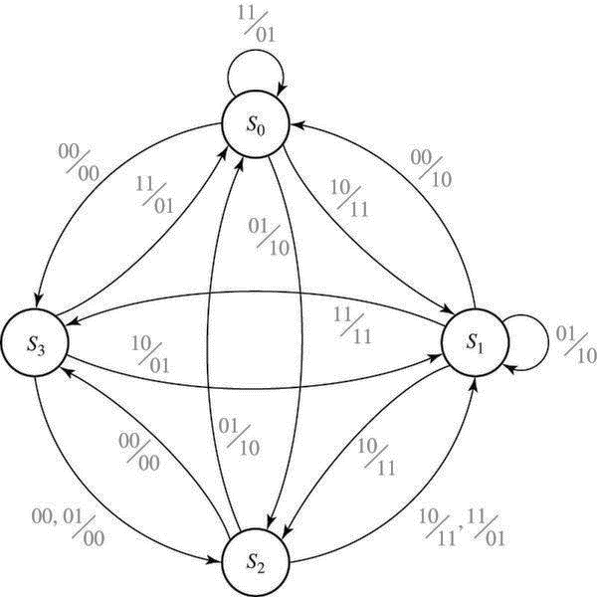
State Diagram
A State Diagram with Multiple Inputs and Outputs

Slide 59
Mealy Machine State Diagrams
A CLARIFICATION:
The state-diagram notation for output values in Mealy machines is a little misleading:
You should remember that the listed output value is produced continuously when the machine is in the indicated state and has the indicated input, (not just during the transition to the next state).

